Slide 1
Loot Box
By: Jacob Corbett, Kelsan Dorjee, Nara Chhuo

Slide 2
About Loot Box
Loot Box is a “Gacha game” where you spend in-game currency to open a specific tier chest and get items specific to that chest with specific probabilities for each item.

Slide 3
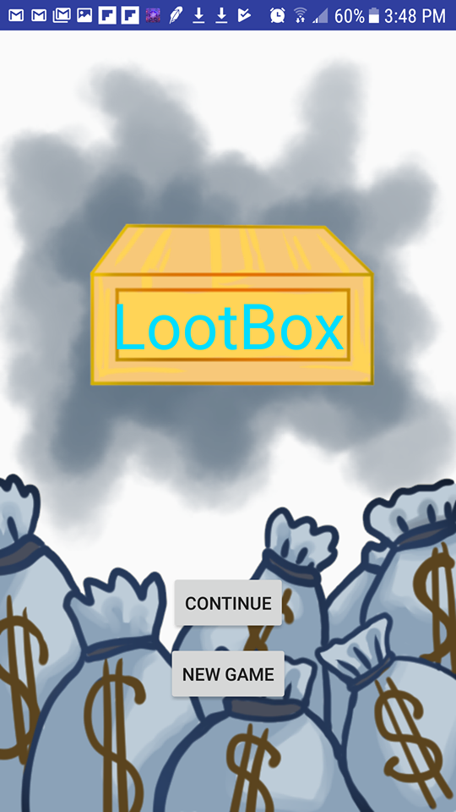
Home Screen
The home screen consists of two buttons.
New game
Continue
The New Game Button will start a new game by returning all the data back to default.
The Continue Button will pick off where the player left, so that means all the items and money acquired will still be there.

Slide 4
Activity Screen
There are four buttons in which a player can choose from.
Ranging:
-Common
-Rare
-Epic
-Legendary

Slide 5
Cont.
Common box Button: If clicked then the price and box will pop up. When you click on on the box, it will open and it will take money away from your bank.
Cost: $100
Rare box Button: If clicked then the price and box will pop up. When you click on on the box, it will open and it will take money away from your bank.
Cost: $1000
Epic box Button: If clicked then the price and box will pop up. When you click on on the box, it will open and it will take money away from your bank.
Cost: $10000
Legendary box Button: If clicked then the price and box will pop up. When you click on on the box, it will open and it will take money away from your bank.
Cost: $100000

Slide 6
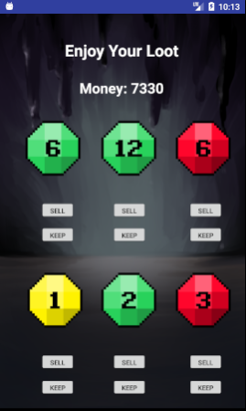
Loot Screen
Loot screen is where the players can get their loot after purchasing a chest.
The loots are random, but the tier of the loot depends on what chest was purchased.
You can either sell or keep each loot depending on whether you already have one. The price is based on the rarity of the specific loot which is shown by color

Slide 7
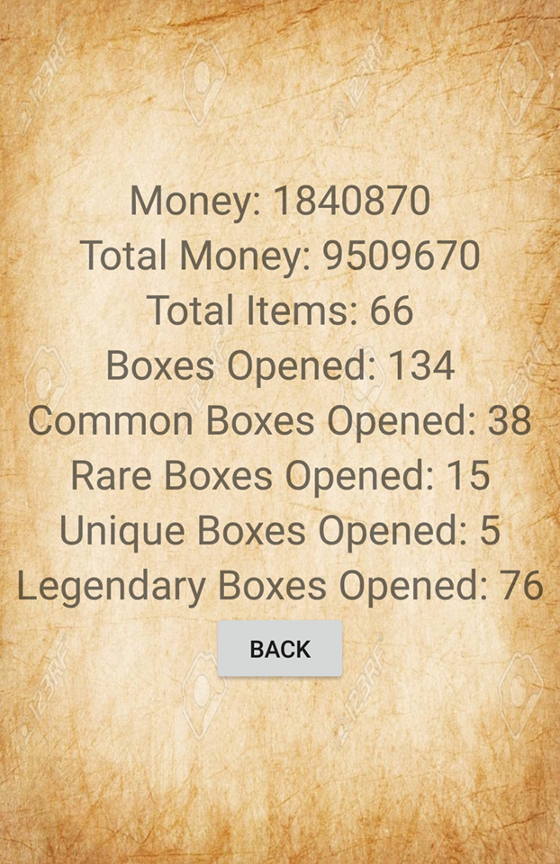
Stats screen
The goal of this game is to collect items, so we made a stats screen with various statistics that our app keeps track of.

Slide 8

Inventory screen
Inventory screen will display the items that the user have acquired during the game play.

Slide 9
Shared Preferences
We use shared preferences instead of database.
You can use SharedPreferences to save any primitive data: booleans, floats, ints, longs, and strings. This data will persist across user sessions (even if your application is killed).
The main purpose is to save private primitive data key-value pairs.

Slide 10
Problems we ran into
Changing Background
Database/Shared preferences
Retrieving data for each item
A certain someone not giving an Id to views

Slide 11
Future Developments
Unique looking items with names
Update inventory activity to show an enlarged picture when clicked on with a name and description for each item
Sell all button unlock
Achievement system

Slide 12
QUESTIONS?

